Slide 1
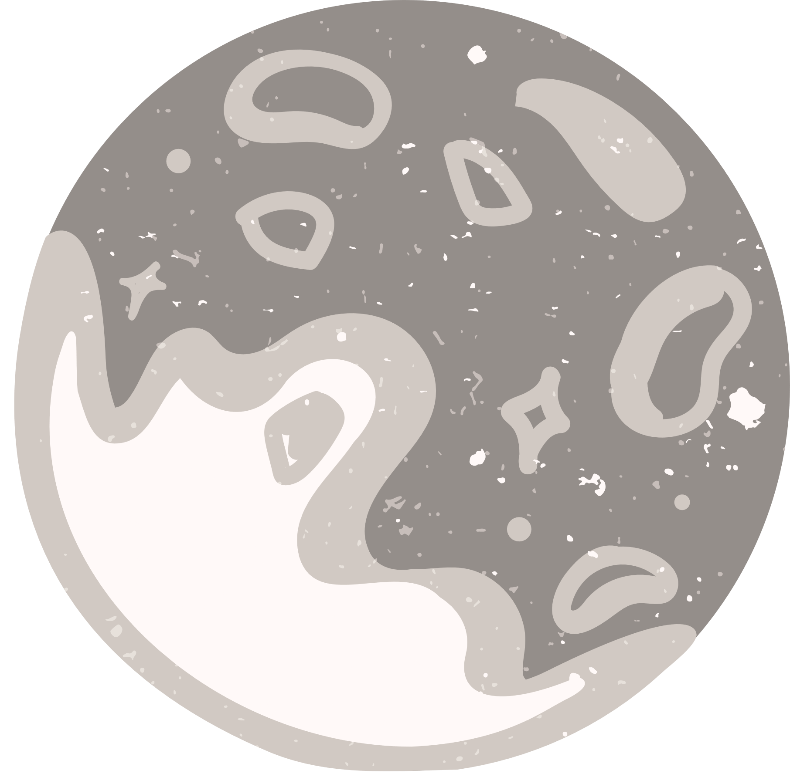
Space Environment Radiation Testing
On Electrical Components
Mairely Urias, Dr. Hugh Barnaby
Arizona State Univeristy
School of Electrical, Computer, and Energy Engineering
2023 Arizona/NASA Space Grant Symposium
April 22, 2023

Slide 2
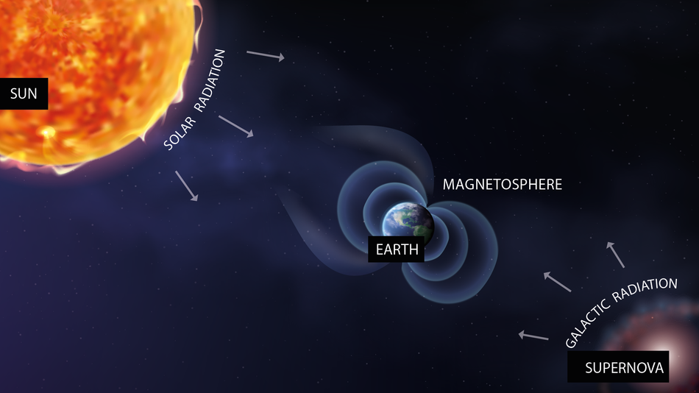
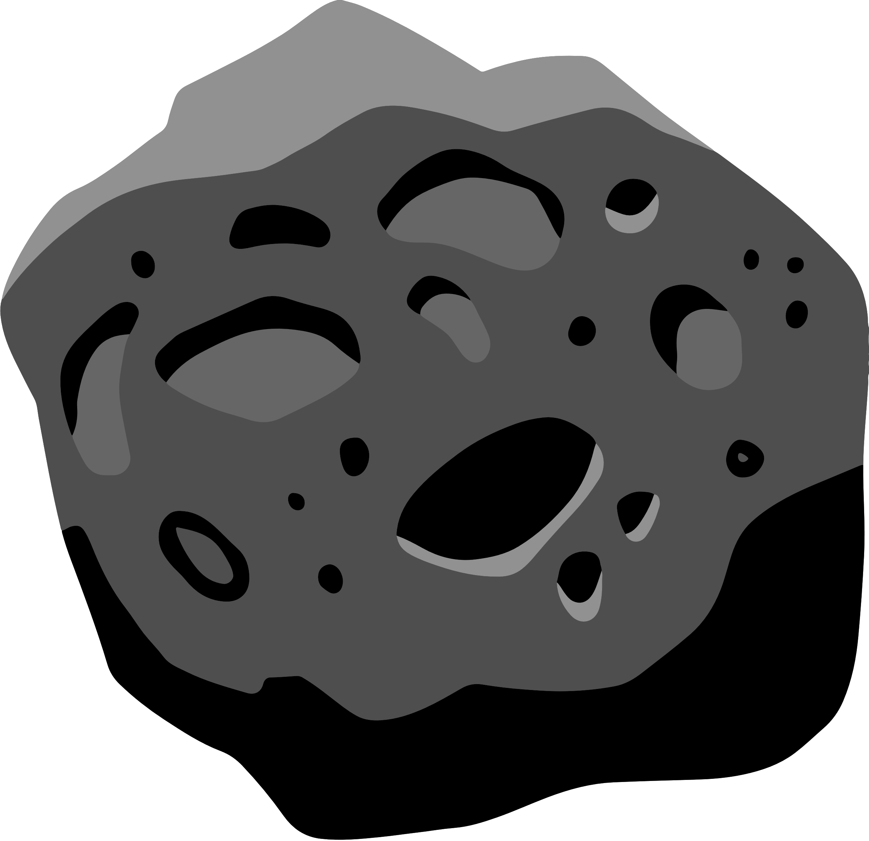
SPACE RADIATION
Radiation: Energy that is emmited in the form of rays, electromagnetic waves, and/or particles
Space Radiation: made up of atoms in which electrons have been stripped away as atoms accelerate in interstellar space to speeds approaching the speed of light, Ionizing Radiation
Sources:
Particles trapped in Earth's magnetic field
O1
O2
Solar particle events
O3
Galactic cosmic rays

Slide 3
RADIATION EFFECTS IN ELECTRONICS
Upsets/Anomalies:
Loss of data
Spurious signals
Phantom commands
Performance degradation
Single Event Effects (SEE) in microelectronics:
1101 0101
Electromagnetic pulses
Range from transient, cumulative, permanent, recoverable, or destructive
SYSTEM FAILURE

Slide 4
SINGLE EVENT EFFECTS
TOTAL IONIZING DOSE
Individual incidents
Single highly energetic particle
Soft errors:
Non-destructive, bit flips, logic transients
Hard errors
Permanent functional effects
May or may not be destructive
Latch-ups, burnouts, gate ruptures
Cumulative, long term
Caused by all ionizing radiation sources
Performance degradation
Potentially leads to failure over time
Voltage shifts, leakage currents, gain degradation

Slide 5
ANALOG FAILURES
POWER FAILURES
Performance Degradation
Operational Failures
Power Control Malfunctions
CODE/ALGORITHM FAILURES
DIGITAL FAILURES
Memory Corruption
Soft Errors
1101 0101
Code Corruption

Slide 6
RADIATION HARDENING BY DESIGN
O1
Identify failure mechanisms
GOALS
O2
Identify radiation effects responsible
INCREASE RELIABILITY
O3
Measure radiation effects & failure mechanisms
INCREASE LIFESPAN
O4
Use knowledge to improve design
REDUCE/ELIMINATE SUSCEPTIBILITY TO FAILURE MECHANISMS

Slide 7
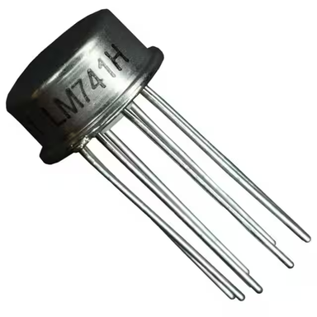
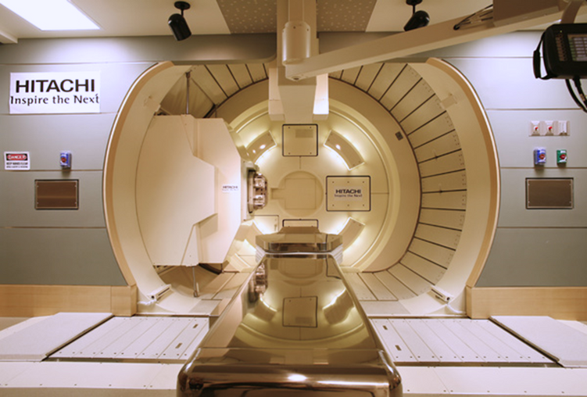
DEVELOPING A TEST INTERFACE
Selected DUT:
LM741 Operational Amplifier
General purpose, commonly used as noninverting
Overload protection on input and output
No latch-up when range is exceeded
Radiation Source:
Hitachi ProBeat IV Synchotron-based pencil beam scanning system at Mayo Clinic, Phoenix, AZ

Slide 8
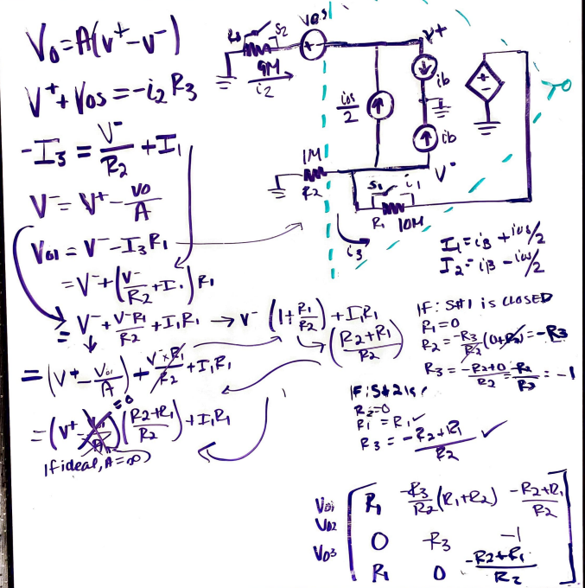
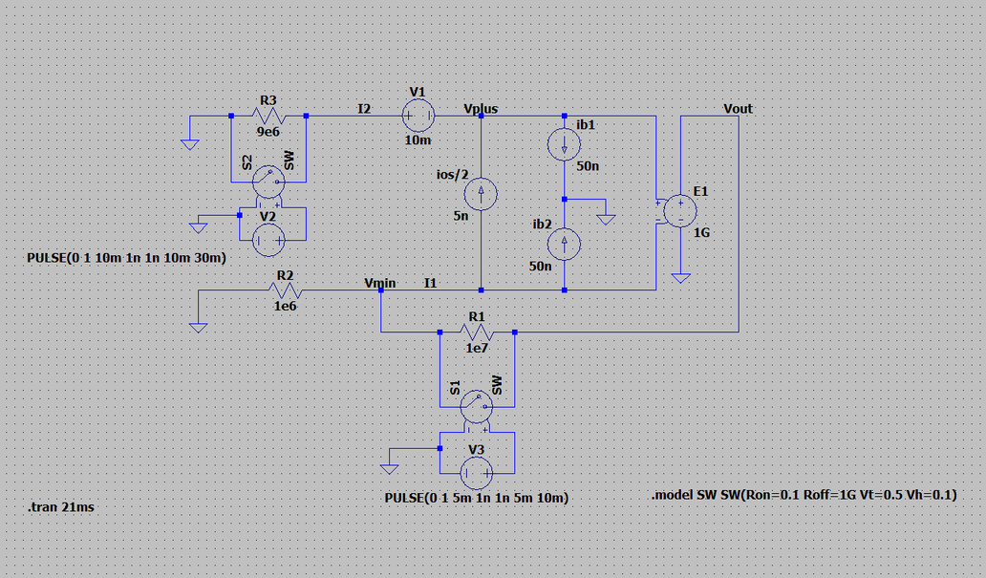
DEVELOPING A TEST INTERFACE, CONT.
Circuit Analysis
Simulation:
LTSpice

Slide 9
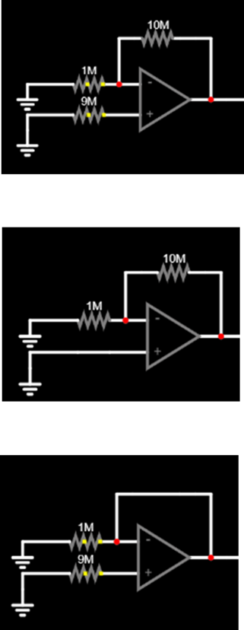
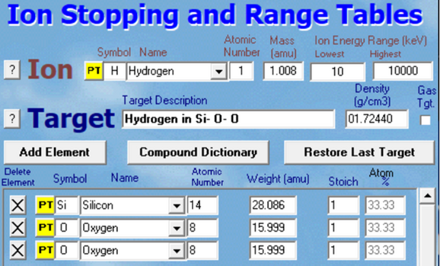
DEVELOPING A TEST INTERFACE, CONT.
Testing Parameters:
SRIM
Testing Configurations:
Arduino
Configuration #1 : (000)
Switch 1: LOW Exp. Output:
Switch 2: LOW -4.226 V
Switch 3: LOW
Linear Energy Transfer (LET): energy deposited per unit track length, normalized to density (MeV-cm2)
Total Ionizing Dose (TID): measure of energy absorbed by a unit mass per matter, or rad, by ionizing radiation.
Configuration #2 : (100)
Switch 1: HIGH Exp. Output:
Switch 2: LOW -0.425 V
Switch 3: LOW
September 2022
•200 MeV protons
•5mm beam diameter
•90% uniformity
•Measurement Points (Fluence) :
•Post 5 x 10^11 cm-2
•Post 2.5 x 10^12 cm-2
November 2022
•200 MeV protons
•5mm beam diameter
•90% uniformity
•Measurement Points (Fluence) :
•Post 1 x 10^12 cm-2
•Post 5 x 10^12 cm-2
Configuration #3 : (011)
Switch 1: LOW Exp. Output:
Switch 2: HIGH -0.570 V
Switch 3: HIGH

Slide 10
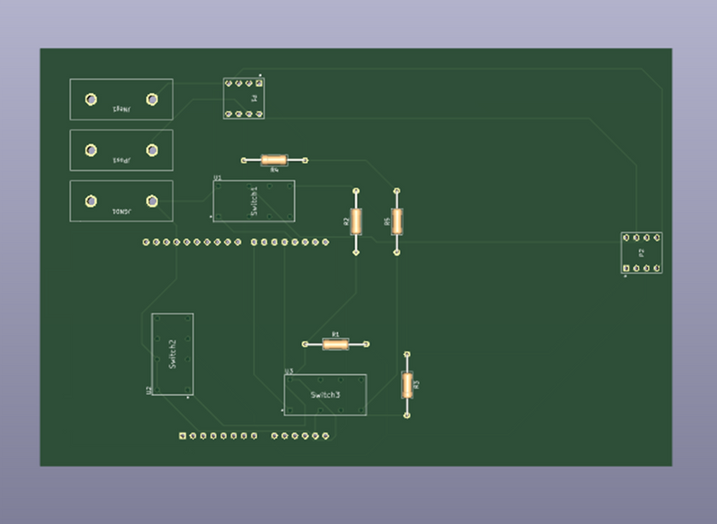
DEVELOPING A TEST INTERFACE, CONT.
PCB Design:
KiCad

Slide 11
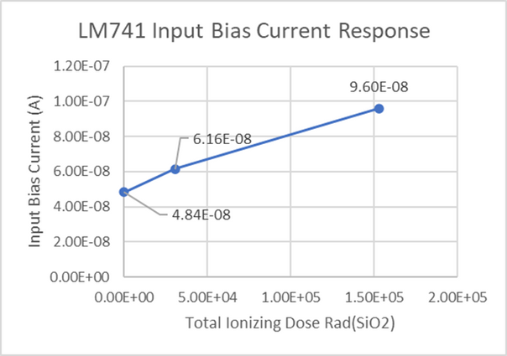
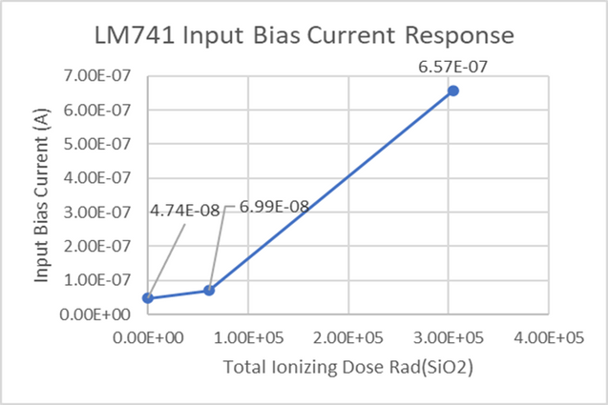
TEST RESULTS
SEPTEMBER RESULTS
Consistent with long-term radiation Total Ionizing Dose (TID) effects
Deleterious to device operation
NOVEMBER RESULTS

Slide 12
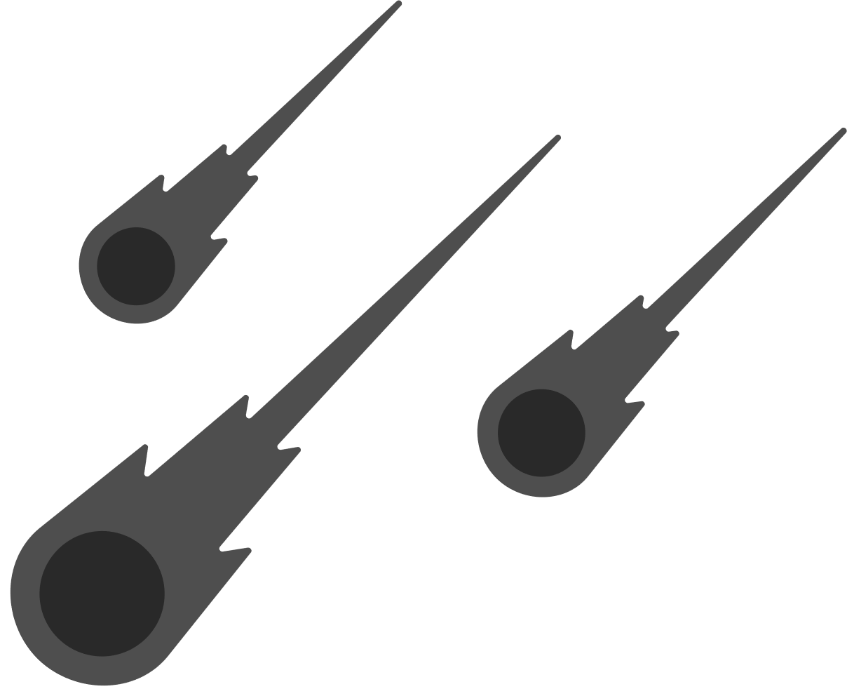
DATA INTERPRETATION
Data shows damage prolonged radiation exposure can cause in LM741
Changes in input bias current affect performance:
Increased power consumption
Inaccurate output readings
Continued testing important for safety and reliability of space missions

Slide 13
VERSION 2
Multi-DUT
Linear Bipolar Circuits
MOS
Diodes
FPGA
More parameter data
Slew Rate
Temperature
Voltage Range
Multi-use

Slide 14
Questions?

Slide 15
Acknowledgments
A special thanks to :
Dr. Hugh Barnaby, for the guidance and mentorship
Dr. Daniel Robertson and the Radiation Oncology Research Committee at the Mayo Clinic for allowing and facilitating the use of proton beam for academic use
ASU/NASA Space Grant Consortium

